Slide 1
BUS TICKET RESERVATION SYSTEM
A MINI PROJECT
DEPARTMENT OF COMPUTER SCIENCE AND ENGINEERING
NBKRIST

Slide 2
TEAM MATES
TEAM OF THREE
1.SANJAY (24KB1A05FH)
-PROJECT MEMBER
2.VARUN (24KB1A05NJ)
-PROJECT MEMBER
3.GAFOOR (24KB1A05HJ)
-PROJECT MEMBER AND FIGURE HEAD
THE TEAM ESTABLISHED AND PREPARED THE SOURCE CODE FOR THE PROJECT UNDER THE GUIDANCE OF
A.SIVANRAJ MCA
TRAINER,BYTEXL

Slide 3
SHORT DETAILINGS OF THE PROJECT
WE,THE MEMBERS OF THE TEAM SHALL DECLARE THAT THE PROJECT BUS TICKET RESERVATION SYSTEM , WRITTEN IN C LANGUAGE COMPRISES ALL THE REQUIRED FULFILLMENTS AND CONDITIONS NECESSARY THAT EMPHASIZES CORRECT INFORMATION ABOUT THE PROJECT .
THE SOURCE CODE IS WRITTEN IN A FORMAT WHICH INCLUDES TOPICS RELATED TO FUNCTIONS,POINTERS AND CONDITIONAL FORMATING.
THE TEAM MEMBERS OF THE PROJECT DID AN EXTENSIVE RESEARCH ON ONLINE RESERVATION SYSTEM BY REFERRING OUT VARIOUS APPLICATIONS AND PUBLIC WEBSITES.NECESSARY ADDITONS AND SHORT ADJUSTMENTS ARE DONE TO CUSOMISE THE CODE IN A FLEXIBLE WAY .
GENERAL INFORMATION,PROJECT DETAILINGS,SOURCE CODE AND OUTPUT IS DISPLAYED IN THE FOLLIWING SLIDES.

Slide 4
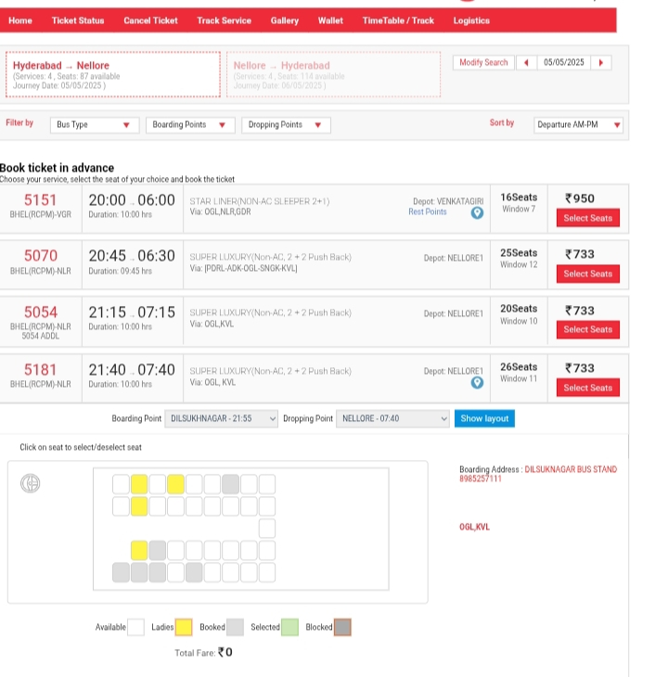
INTRODUCTION
Bus Reservation System is a tool that allows users to book tickets for their journey in advance. This project aims at building a source code for a simple Online Bus Reservation System. A sample bus reservation portal view is displayed below. The website allows to display number of booked seats and availability in addition to the fare of the ticket.

Slide 5
COMPONENTS OF THE CODE
The source code is comprised and able to perform the following tasks:
TICKET BOOKING
TICKET CANCELLATION
DISPLAY RESERVATION STATUS
AVAILABLE SEATS
NUMBER OF BOOKINGS
BOOKING SATUS OF INDIVIDUAL
ESCAPING THE BOOKING

Slide 6
STATUS OF THE SOURCE CODE
The source code is written in C language it comprises of basic functions for various operations regarding ticket bookings , cancellations , etc..
The display function has been established to show the availability of booked seats in a matrix manner which uses linear traversal in a while() loop. The contents are executed in the main() function by using the concept of switch() case .The user selects a specific option and the resultant output is displayed on the screen.
Linked list concept is widely applied to traverse the information and select specific location to display.

Slide 7
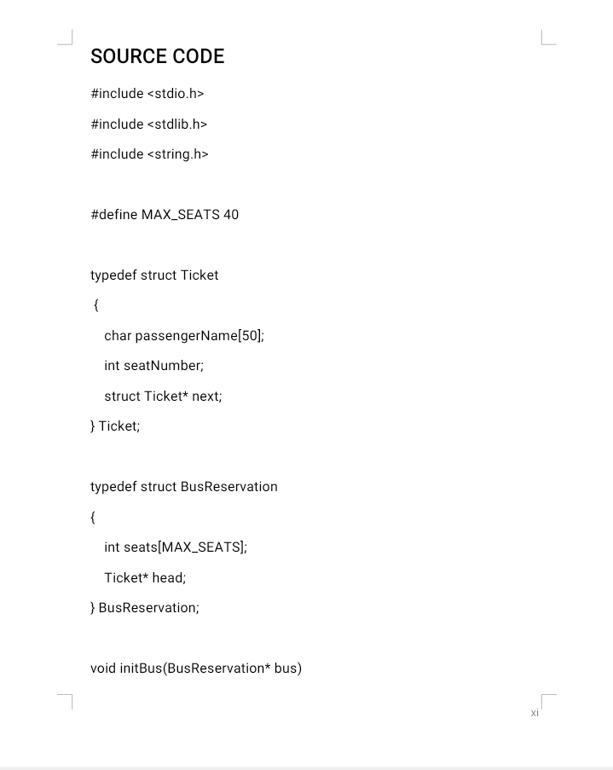
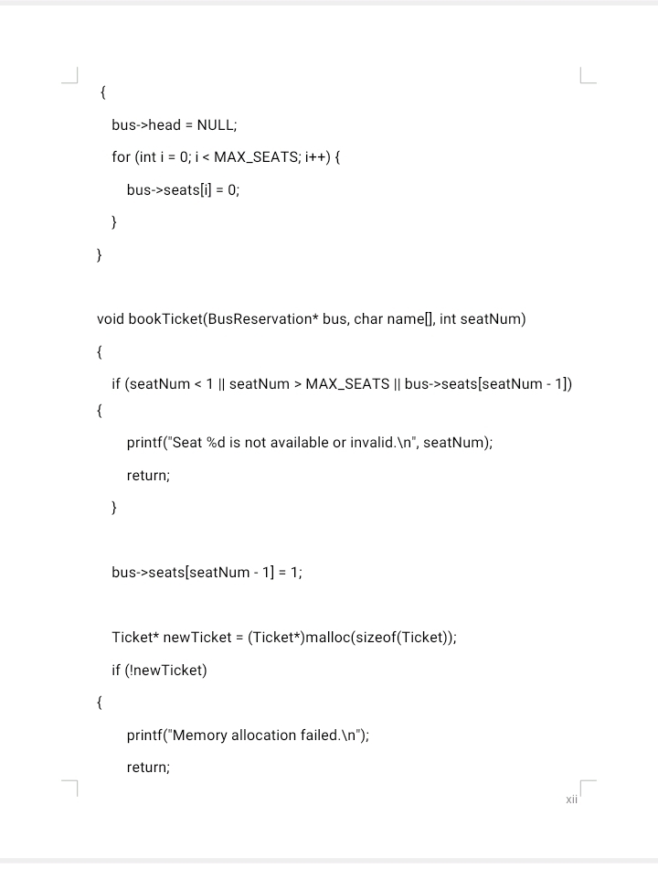
SOURCE CODE

Slide 8
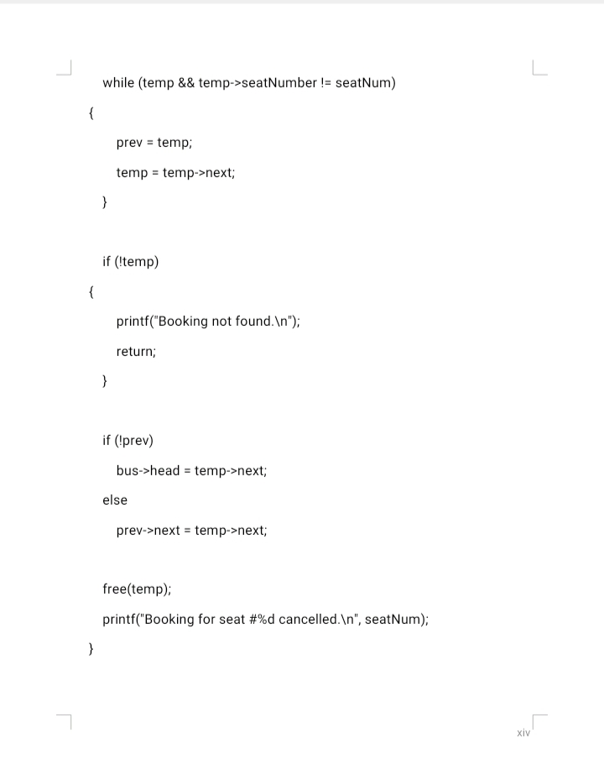
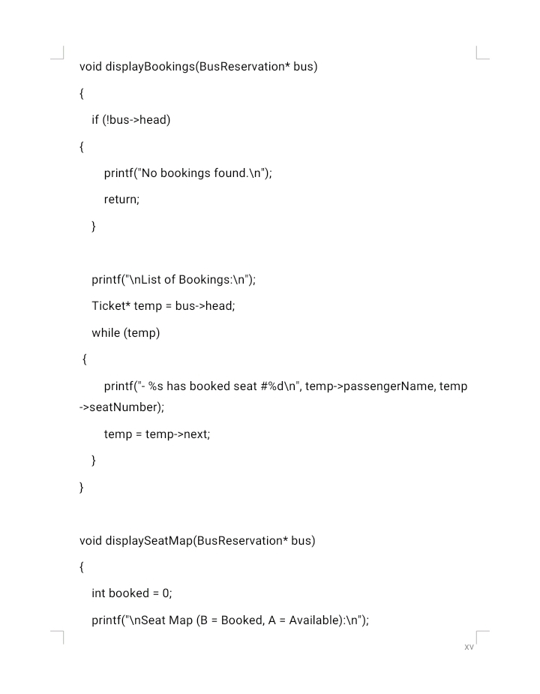
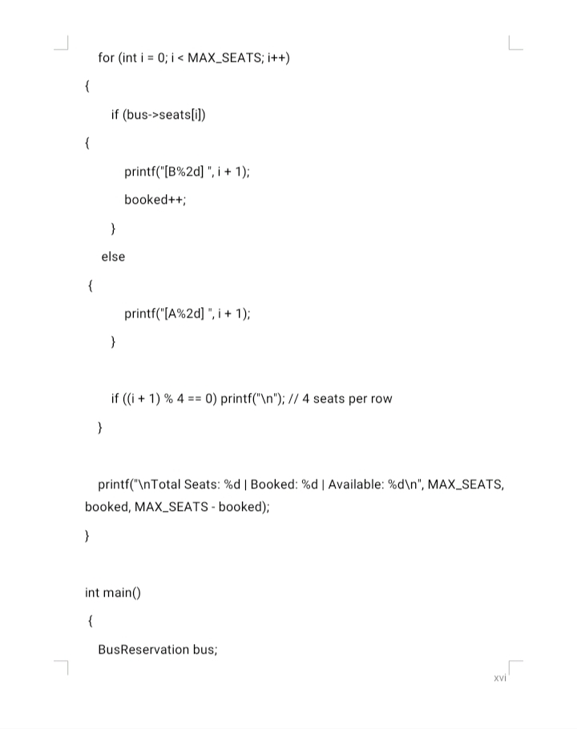

Slide 9
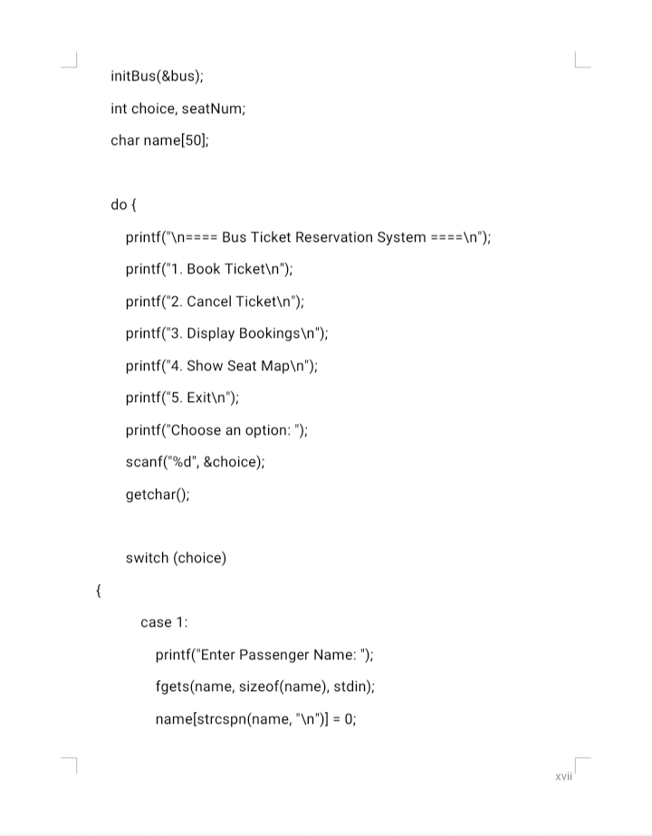
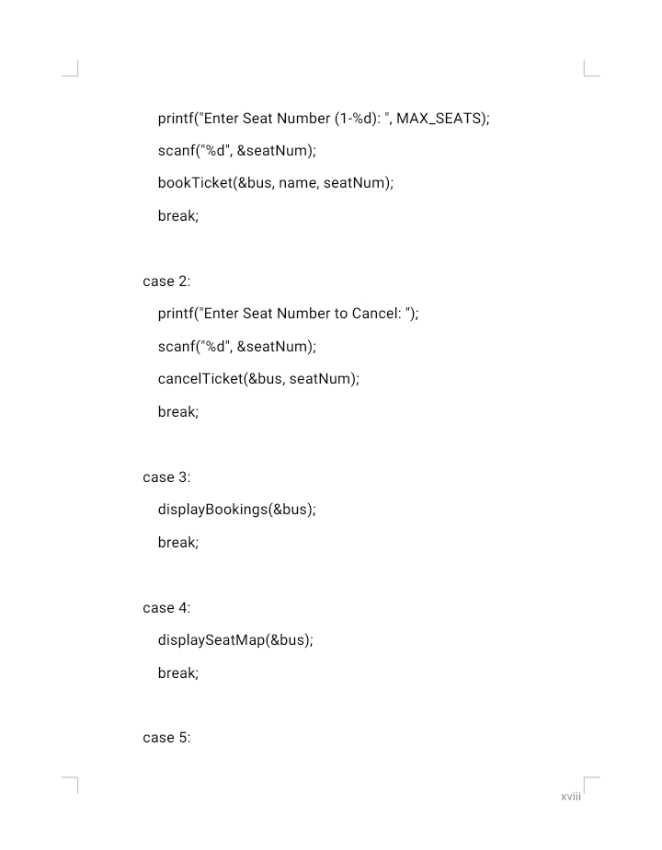
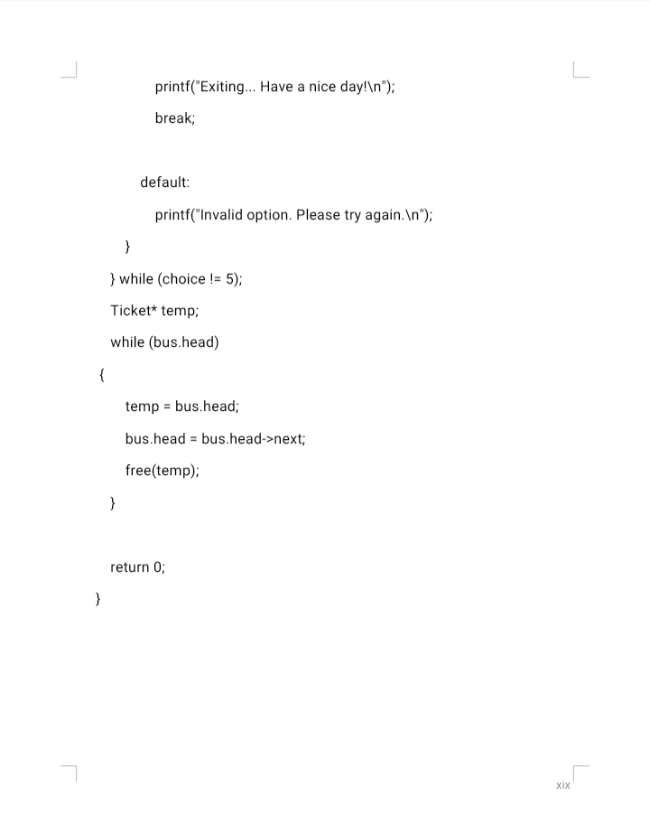

Slide 10
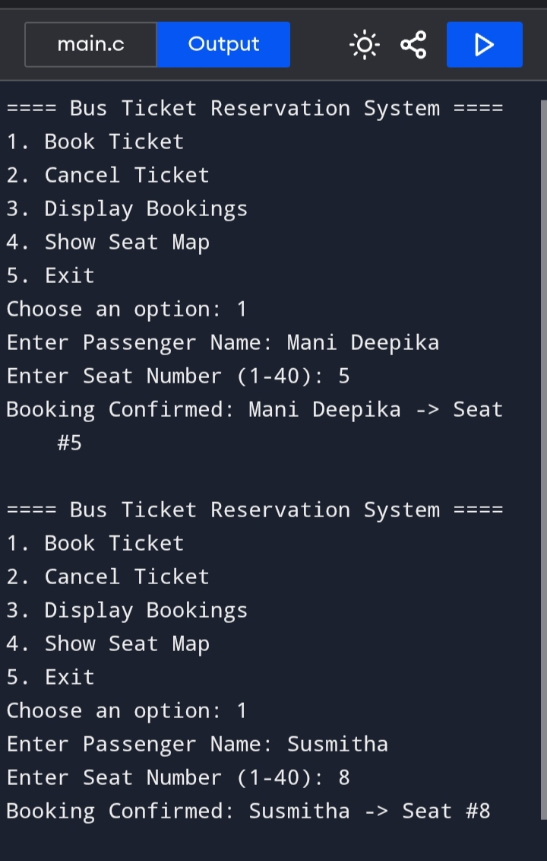
OUTPUT
A SAMPLE OUTPUT IS DISPLAYED HERE.THE CODE IS TESTED WITH RANDOM NAMES REGARDING BOOKING , CANCELLATION AND DISPLAY OF THE RESERVATION STATUS.

Slide 11
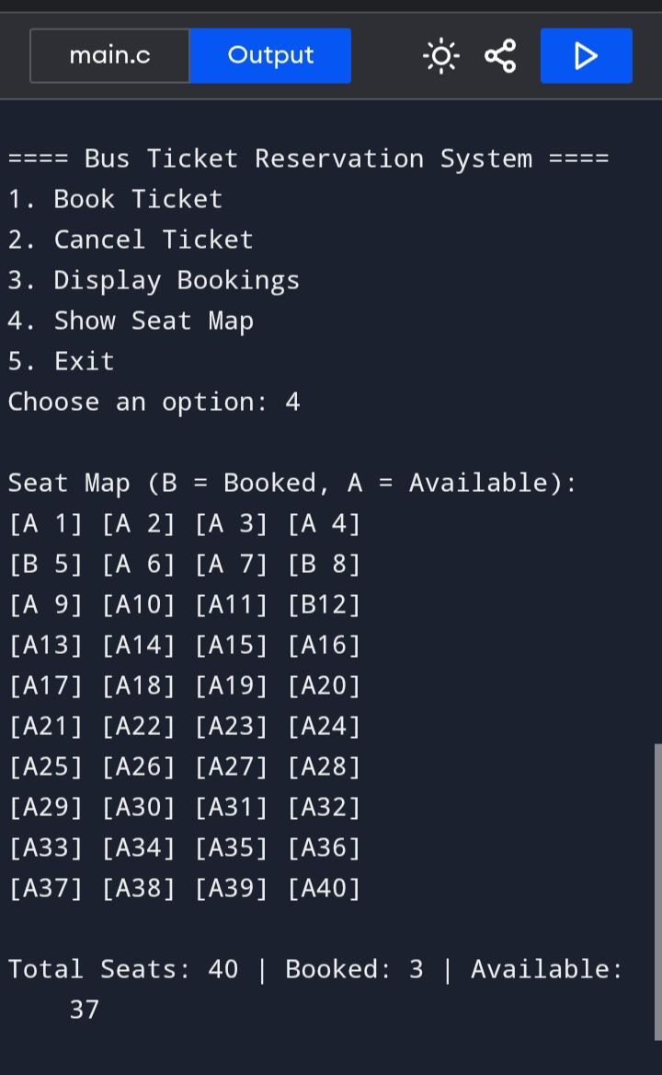
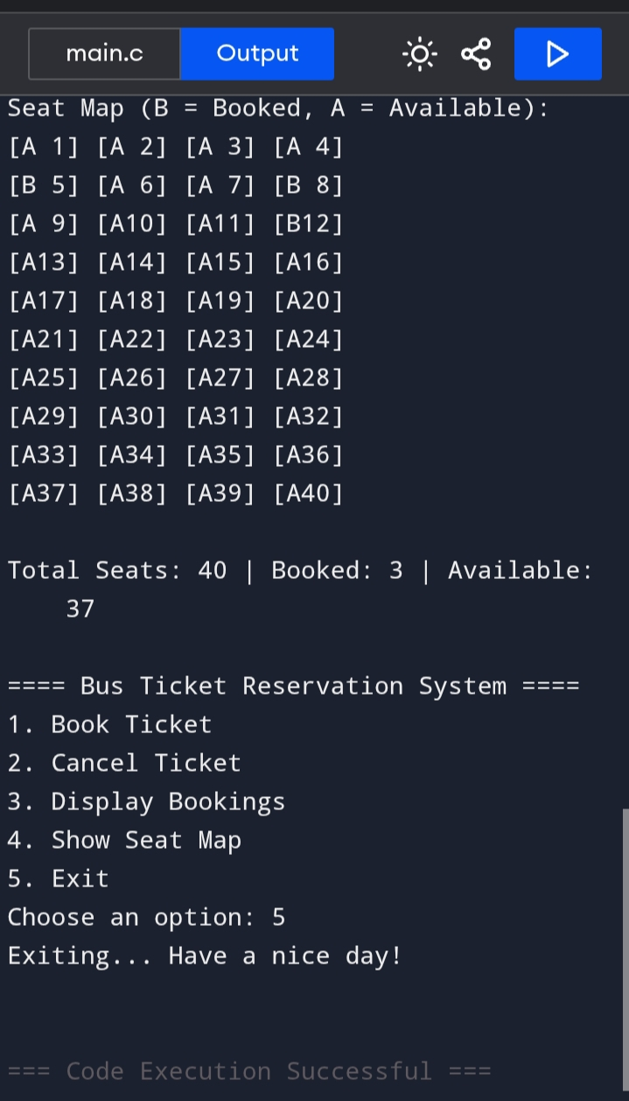

Slide 12
CONCLUSION
WE,THE TEAM MEMBERS SHALL DECLARE THAT THE ABOVE CODE IS EXECUTED WITHOUT ANY ERRORS AND THE PROJECT IS COMPLETED AND PRESENTED WITH ATMOST CARE AND DILIGENCE. THE TASK IS INCORPORATE AND DISCUSSED AMOG OURSELVES.
THE CURIOSITY ON MATHEMATICS AND COMPUTING KNOWLEDGE MADE THE KEEN TO RESEARCH AND DOVELOP CODING SKILLS WHICH THE PROJECT LEAD US INDETAIL.
WE FINALLY THANK OUR TRAINER AND GUIDE WHO WERE WITH US FROM BEGINNING AND ENCOURAGED US FROM FORTH.

Slide 13
THE END...
VOTE OF THANKS
.....By VAMPALA VARUN

